Slide 1

Personal Budget Tracker
Final Python Project Presentation
A comprehensive console-based application demonstrating Python fundamentals through practical financial management.

Slide 2

Project Overview
A console-based Personal Budget Tracker that enables users to manage income, expenses, and budgets efficiently while demonstrating core Python concepts.
Control Structures
Functions
Loops and conditionals for program flow
Modular code organization
File Handling
Object-Oriented Programming
JSON data persistence
Transaction class design

Slide 3

Core Features
1
2
3
Main Menu System
Income & Expense Tracking
Budget Management
Navigate program options with input validation
Record transactions with automatic timestamps
Set monthly limits by category
4
5
Monthly Reports
Data Persistence
Generate comprehensive financial summaries
Auto-save to data.json file
Built with: Python standard libraries only (json, datetime)

Slide 4

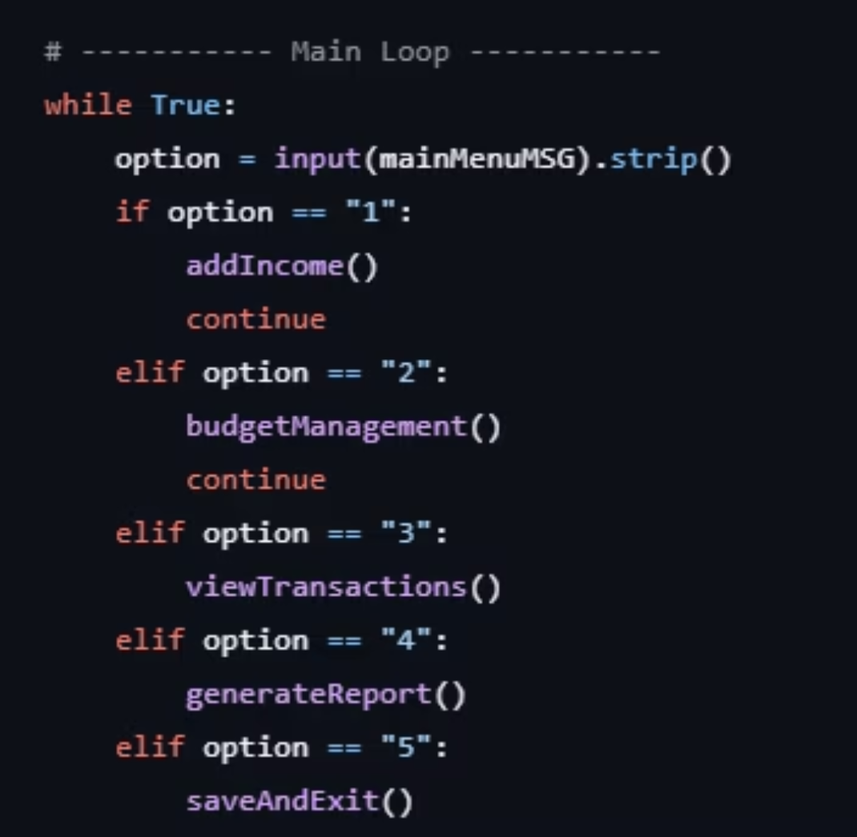
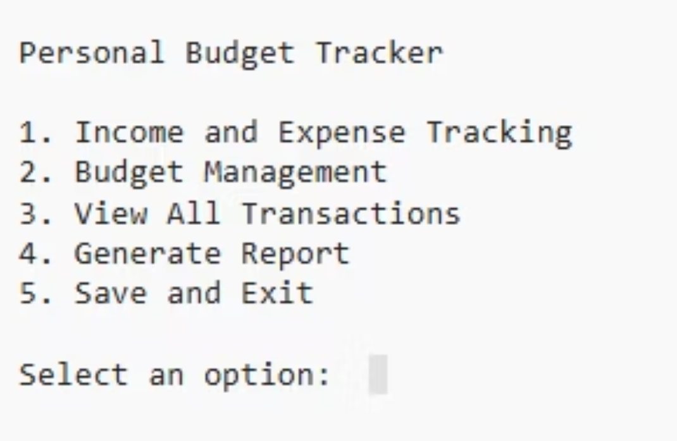
Main Menu System

Slide 5

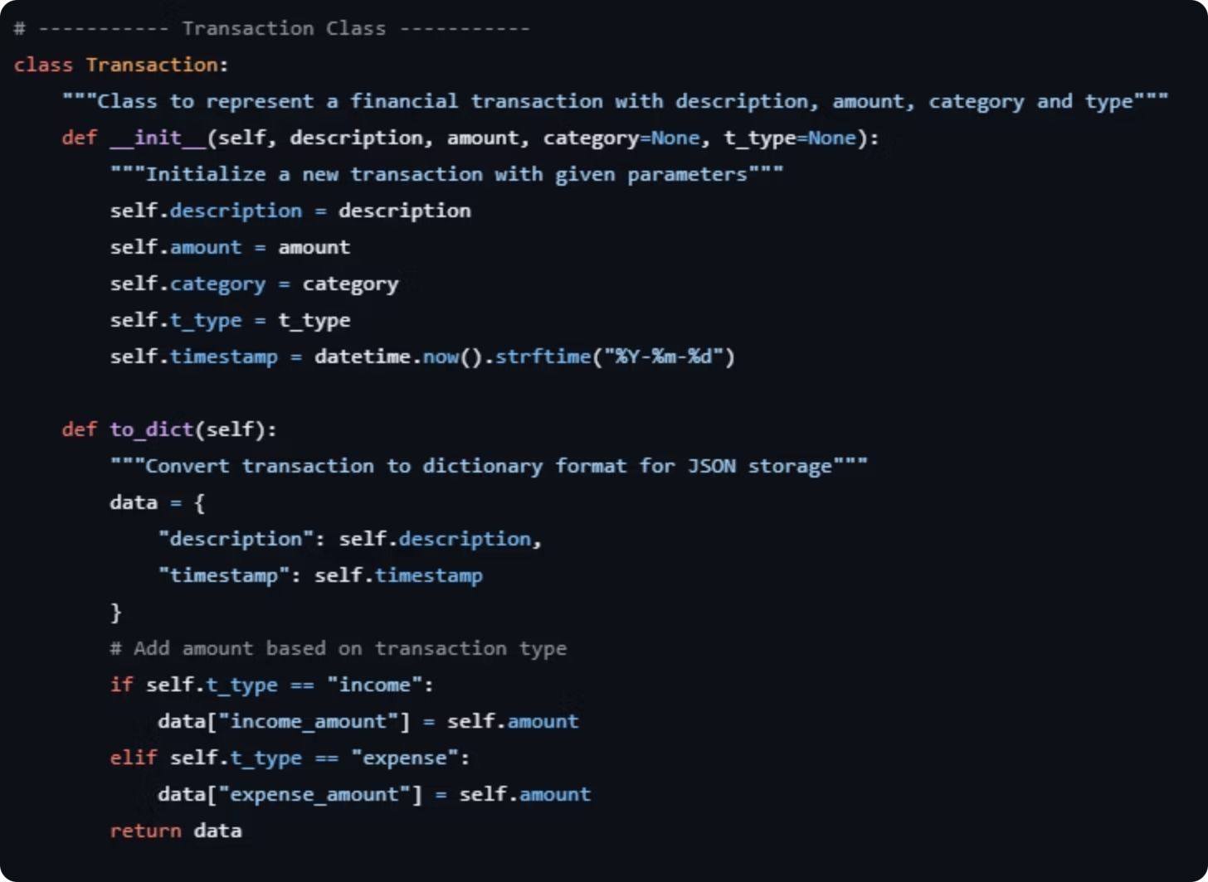
Transaction Class
Object-oriented design demonstrating encapsulation and class-based architecture.
Attributes
1
date, type, category, description, amount
__init__()
2
Initialize transaction details
display()
3
Print formatted transaction info

Slide 6

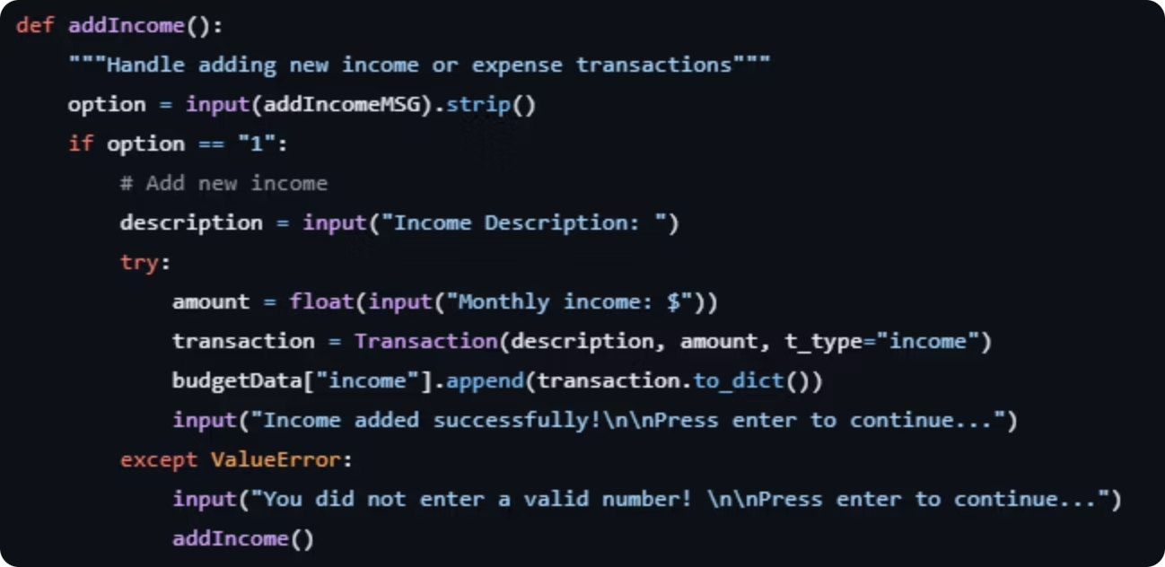
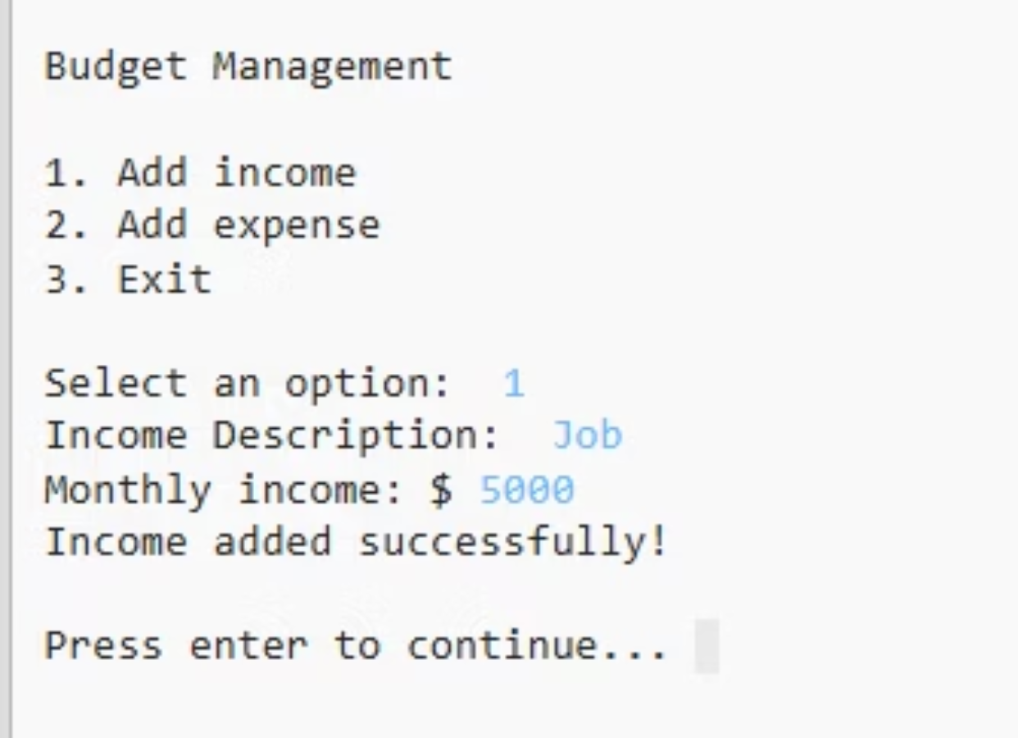
Income Tracking

Slide 7

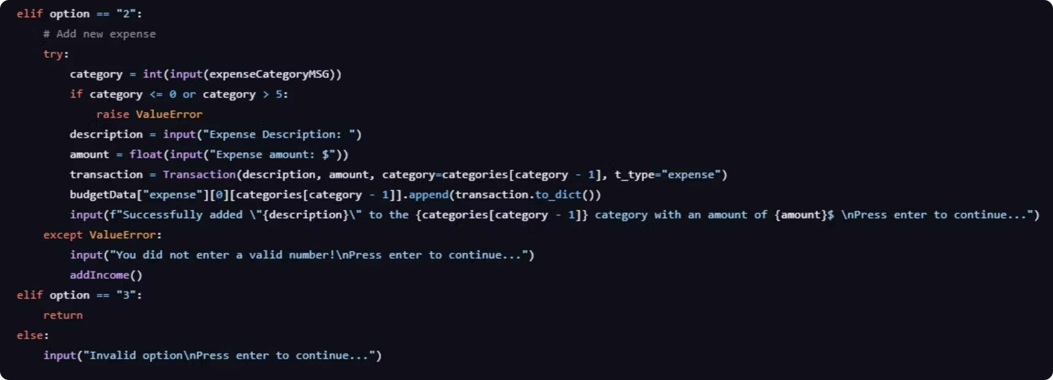
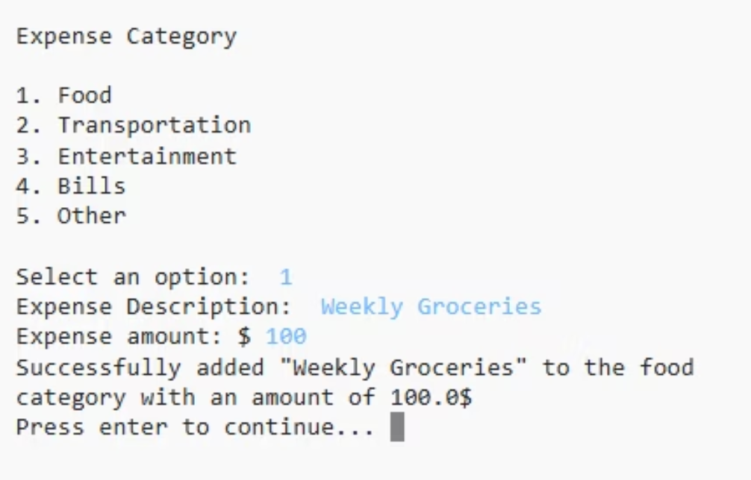
Expense Tracking

Slide 8
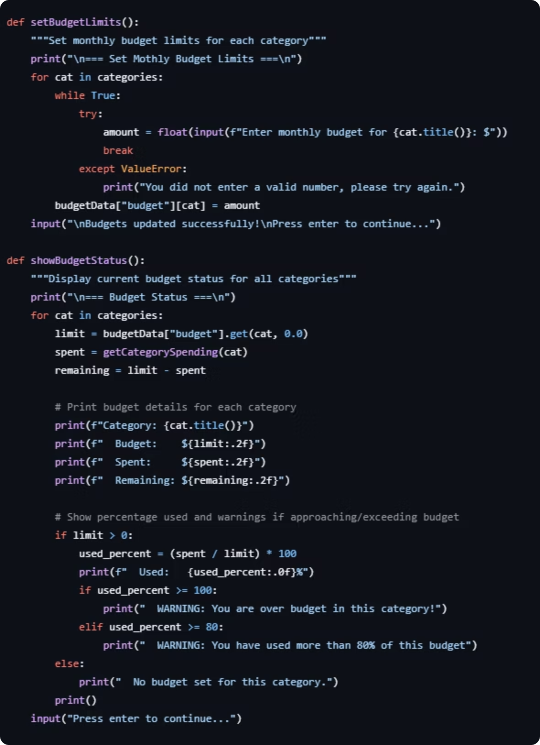

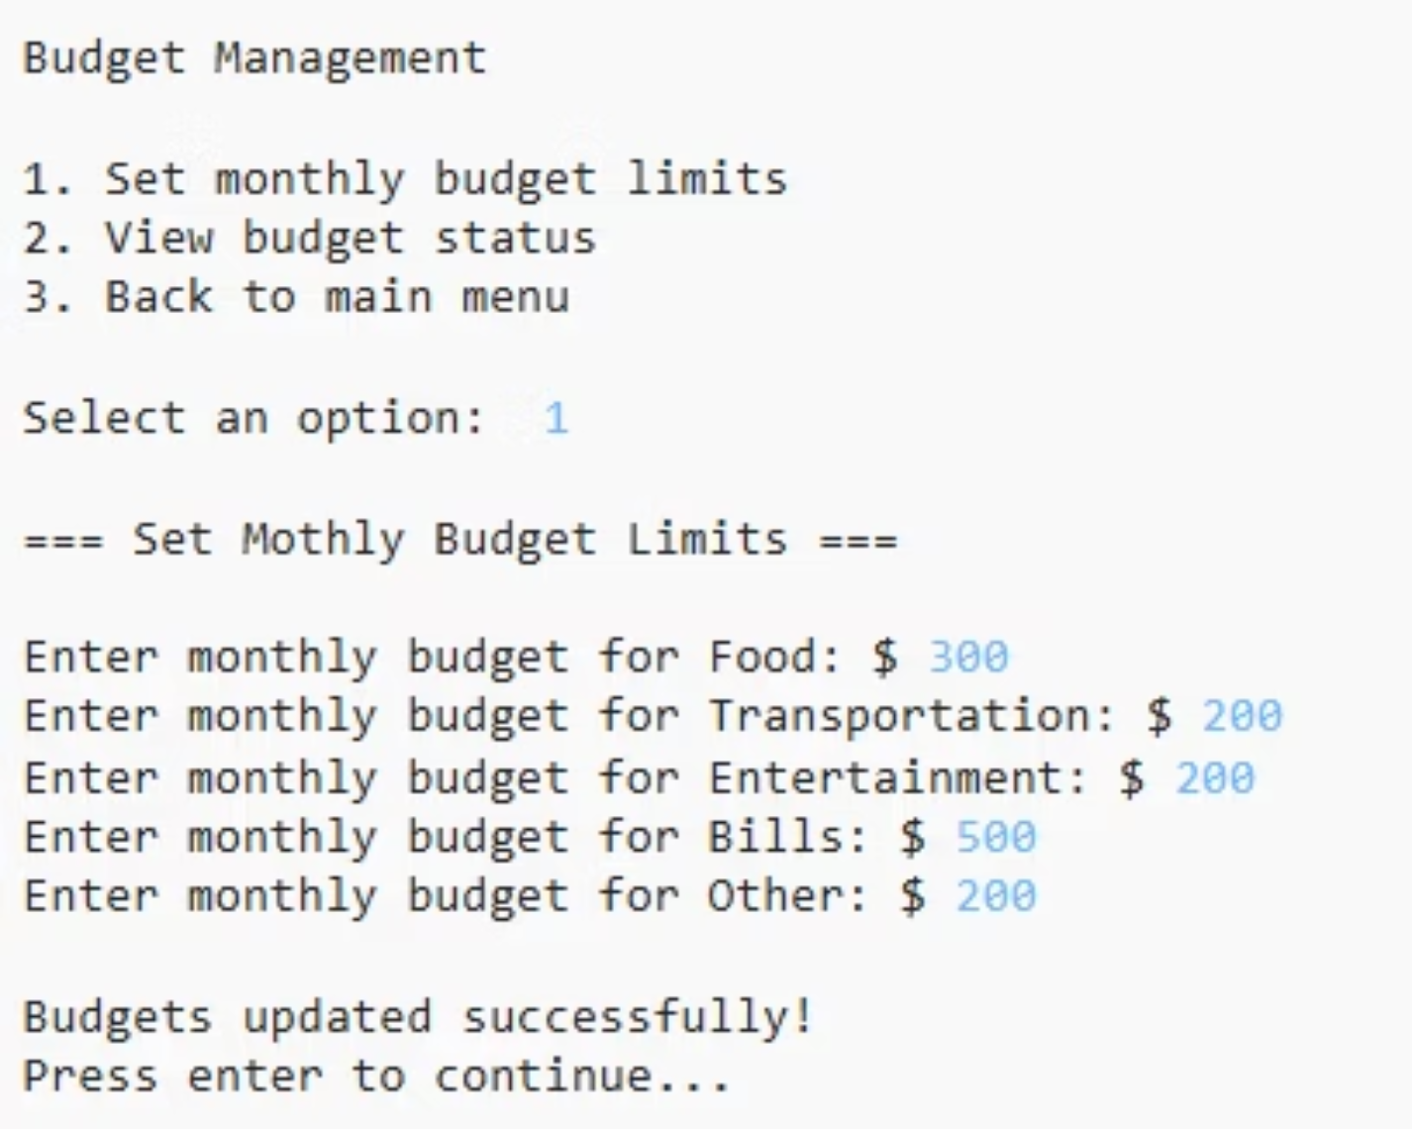
Budget Management
Set monthly spending limits for each category and monitor remaining budget in real-time.

Slide 9

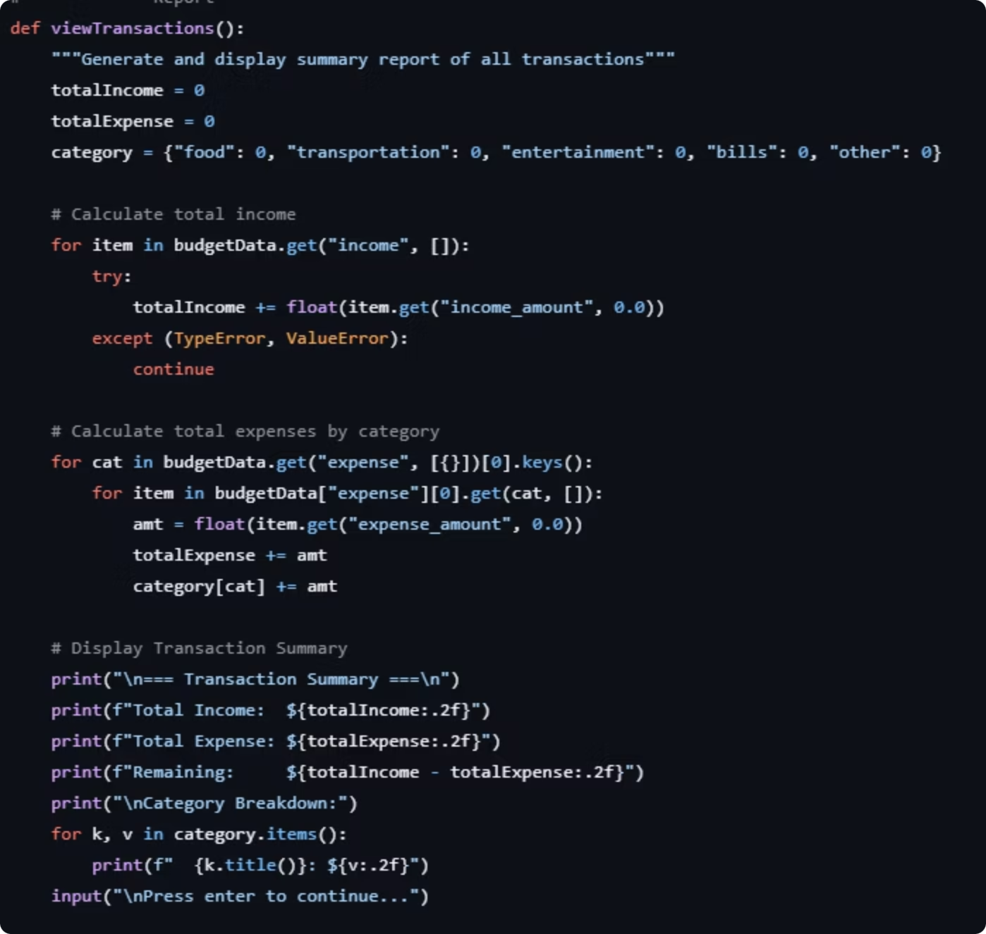
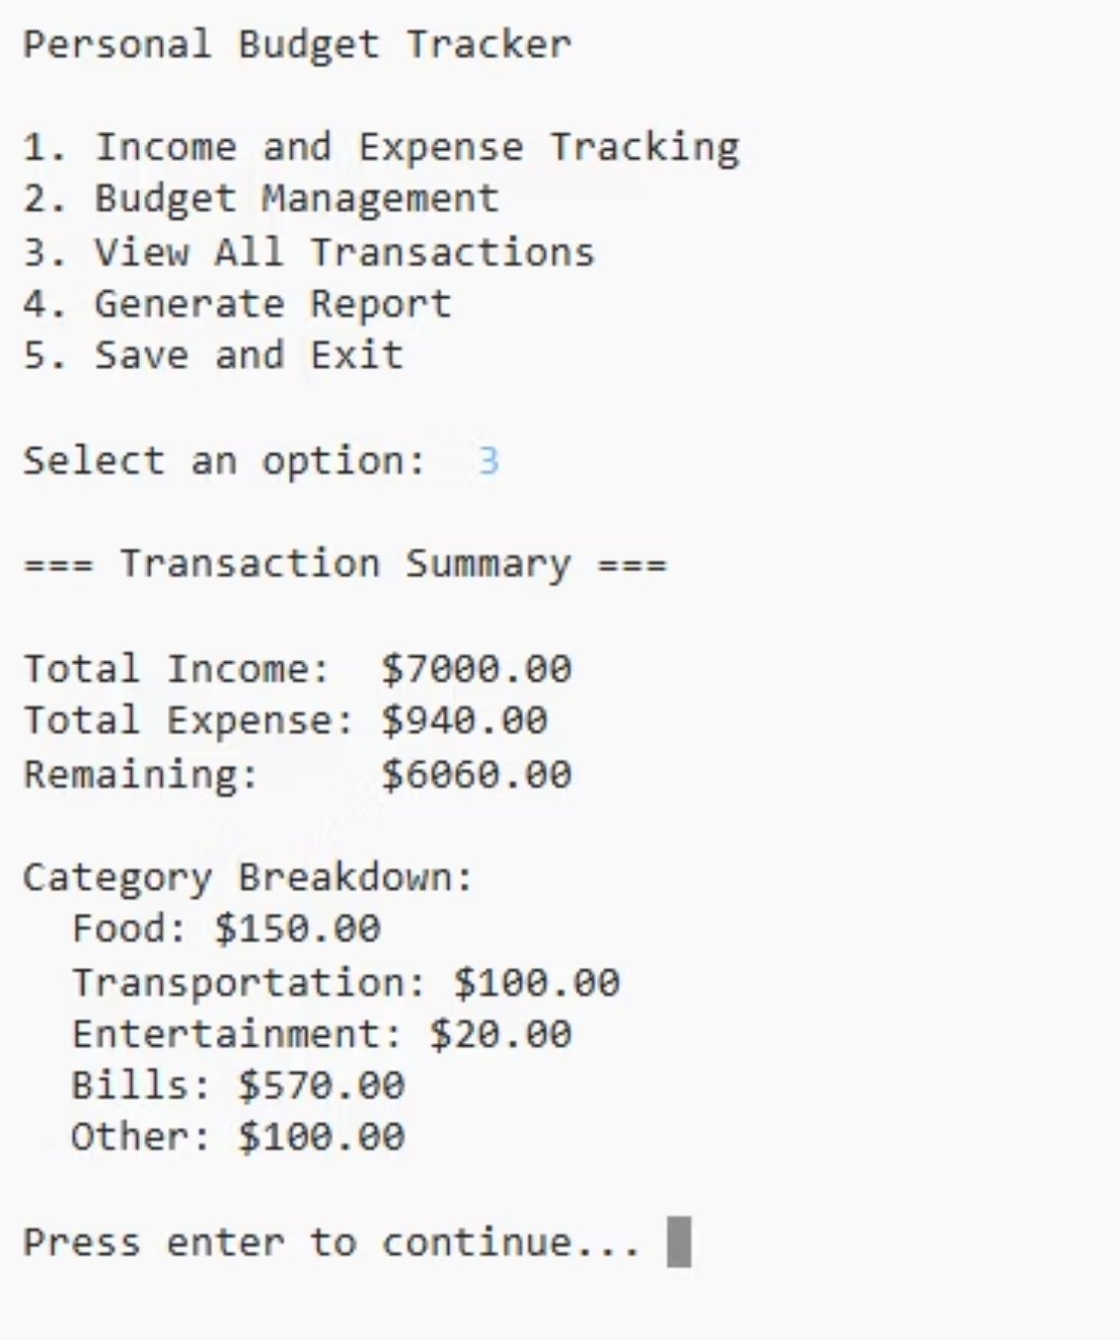
View All Transactions
Display comprehensive financial activity with formatted output for quick review.

Slide 10

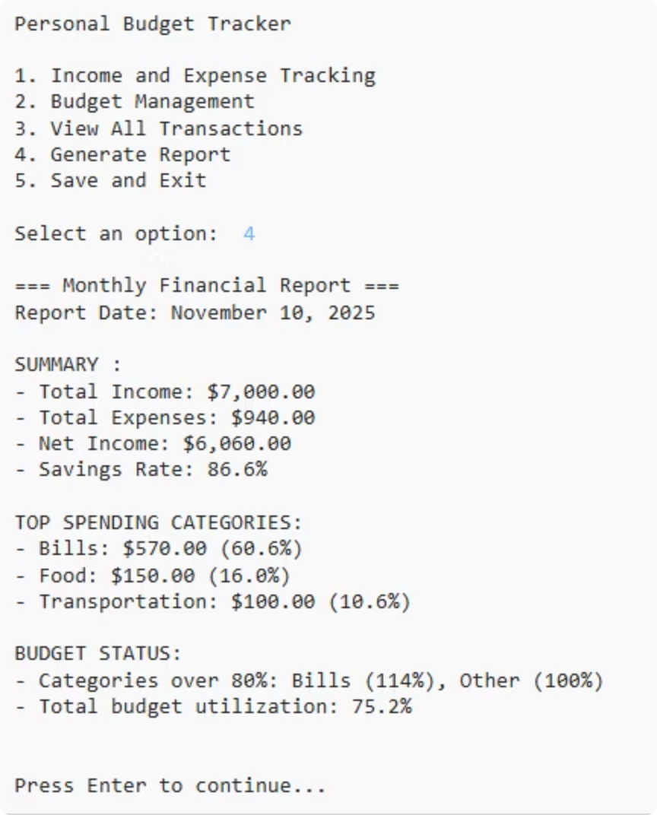
Generate Monthly Report
This function provides a comprehensive financial overview, consolidating all your monthly data into an easily digestible report.
Financial Overview
Summarizes total income, expenses, and net balance, offering a quick snapshot of your financial health.
Performance Metrics
Calculates your savings rate and overall budget utilization to track financial progress and efficiency.
Spending Insights
Identifies your top three spending categories and highlights budget warnings for categories exceeding 80% of their limit.
User Experience
Provides a clear, formatted summary and includes a "Press Enter to continue" prompt for seamless navigation.
Note: Code too long to include full screenshot

Slide 11

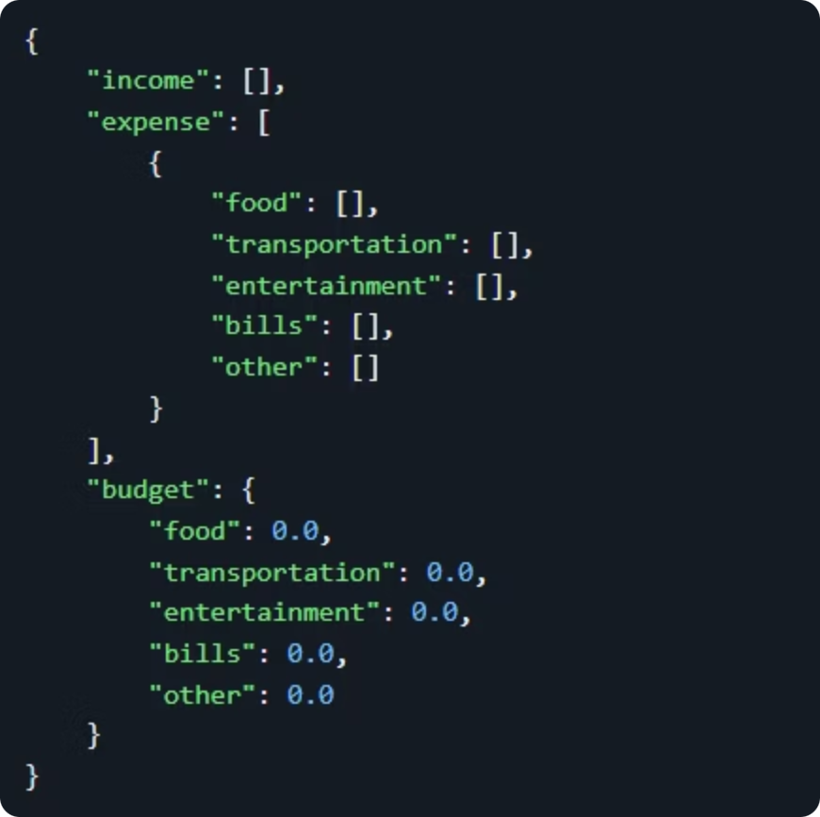



Data Persistence
load_data()
Startup initialization
Process
User transactions
save_data()
Auto-save to JSON
File: data.json Libraries: json Error Handling: try/except FileNotFoundError

Slide 12
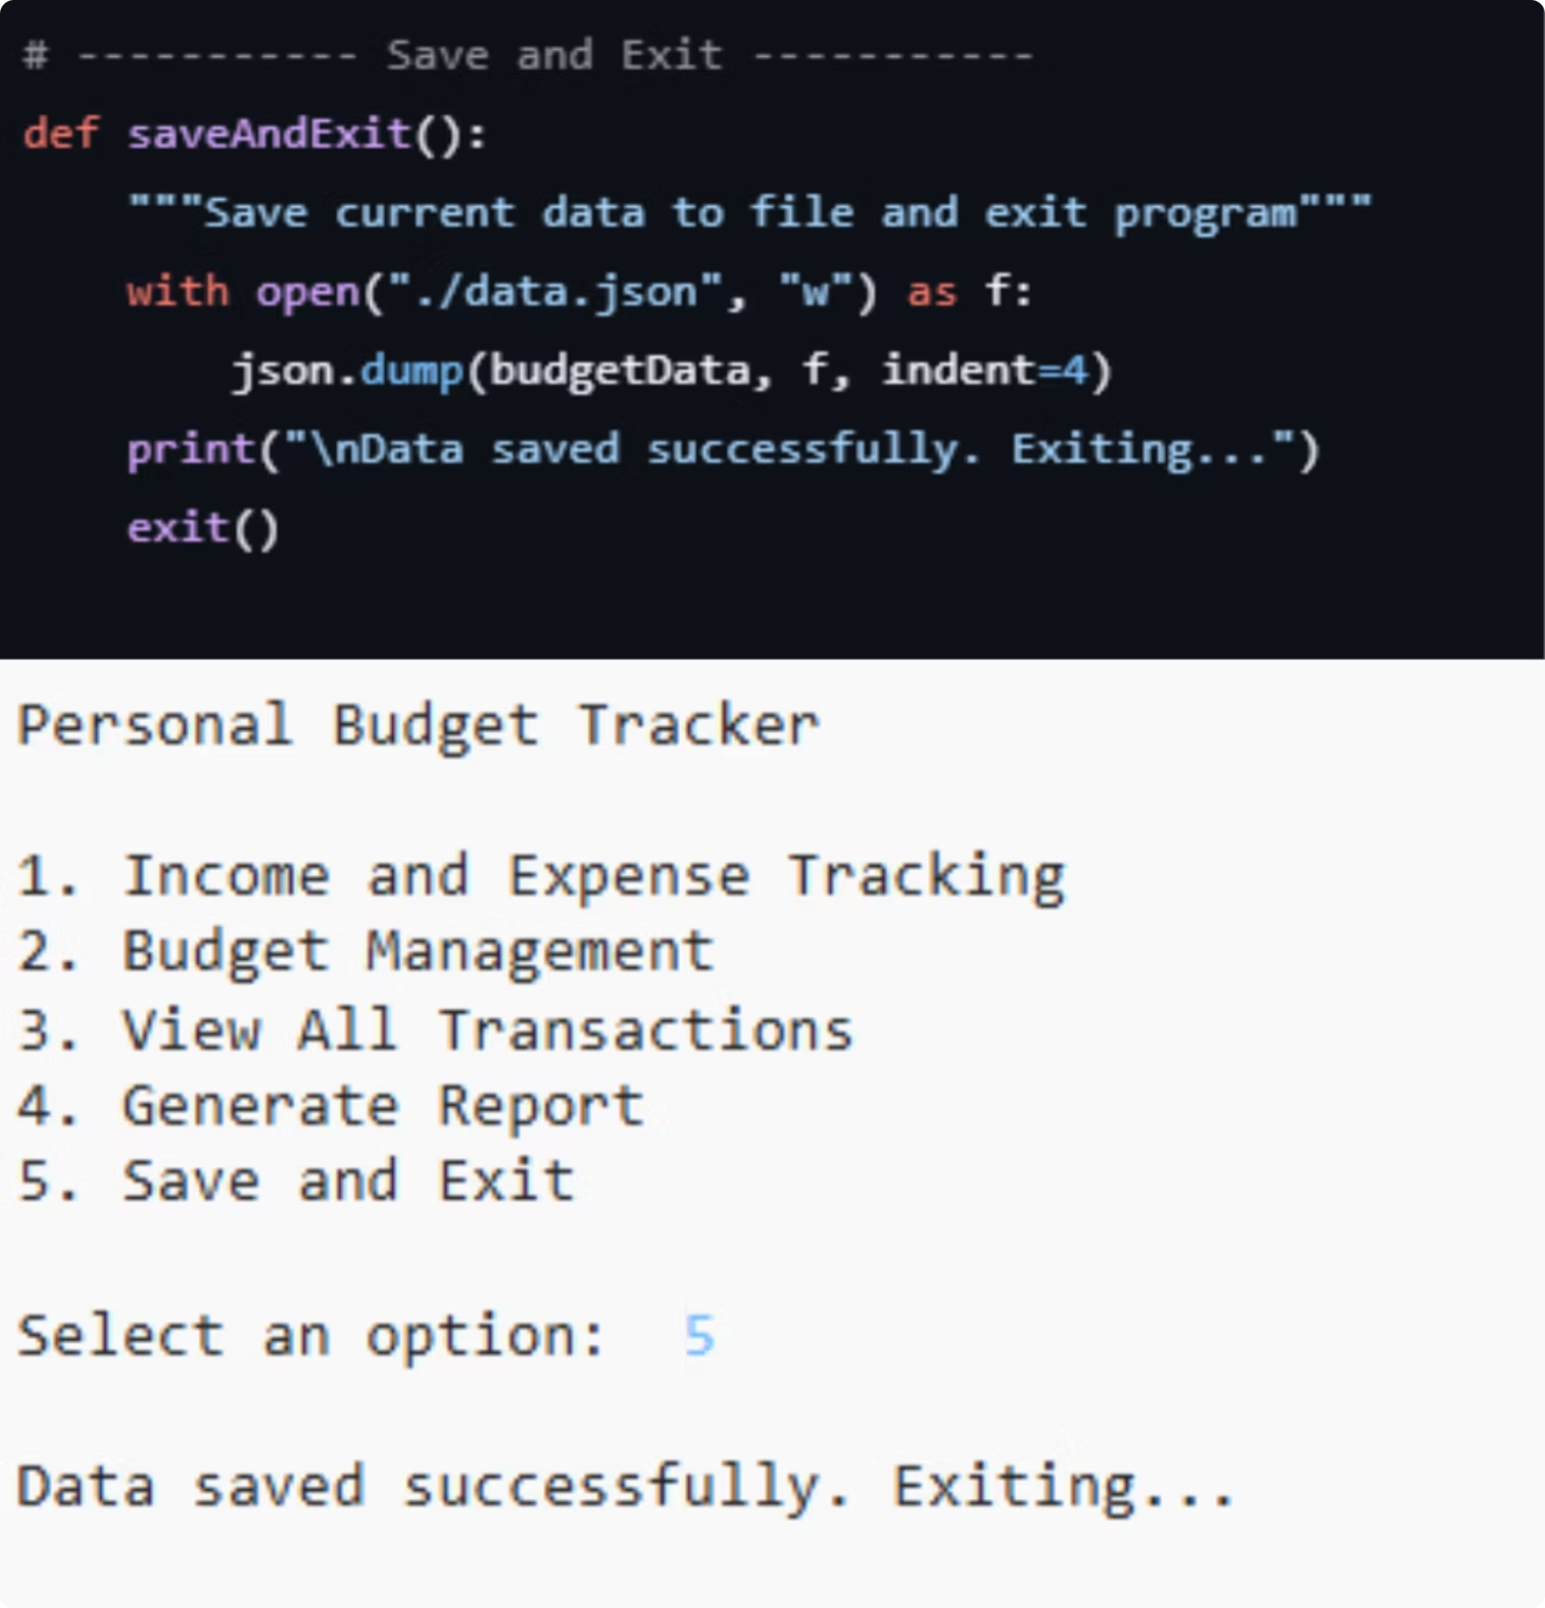
Save and Exit Function
The save_and_exit() function is crucial for maintaining data integrity and providing a seamless user experience.
1
2
Automatic Data Save
Prevent Data Loss
All updated budget and transaction data is automatically written to the data.json file just before the program closes.
This mechanism ensures that no user input or changes are lost when the application is terminated, preserving financial records.
3
Exit Confirmation
A clear message, "Data saved successfully! Exiting...", confirms to the user that their data is secure before the program exits.

Slide 13

Program Demonstration
Witness the Personal Budget Tracker in action, showcasing its intuitive command-line interface and core functionalities.
Adding Transactions
Viewing Records
Generating Reports
Demonstrate how to log income and expenses with category and amount.
Display all recorded transactions for comprehensive oversight.
Show a summary of monthly financial activity and budget adherence.

